Slide 1

Software Engineering Team Project

Slide 2

Team Lead: Andrew McKissick
Devin Ritter, Tellon Smith, Johann Redhead, Anderson Nwammadi

Slide 3
Overview
What is our project?
Team Organization
Diagrams
Development Tools

Slide 4
What is Our Project? Card Services: Wells Fargo
Customer
Dr. Terry Griffin, Assistant Professor at Midwestern State University
Goals
Redesign user interface
Enhance user productivity
Added security features

Slide 5
*User interface screenshots

Slide 6
*User interface screenshots

Slide 7

Team Organization Communication

Slide 8
Team Organization Communication
What is Slack?
Mobile application
Individual or group chat
What did we use Slack for?
General communication
Suggestions on works
Coordination of assignments and deadlines

Slide 9


Team Organization File Management

Slide 10
Team Organization File Management
What is GitHub?
Git repository hosting service
Web-based graphical interface
Control and collaboration features
What did we use GitHub for?
Open storage for files
Upload and download individual works

Slide 11
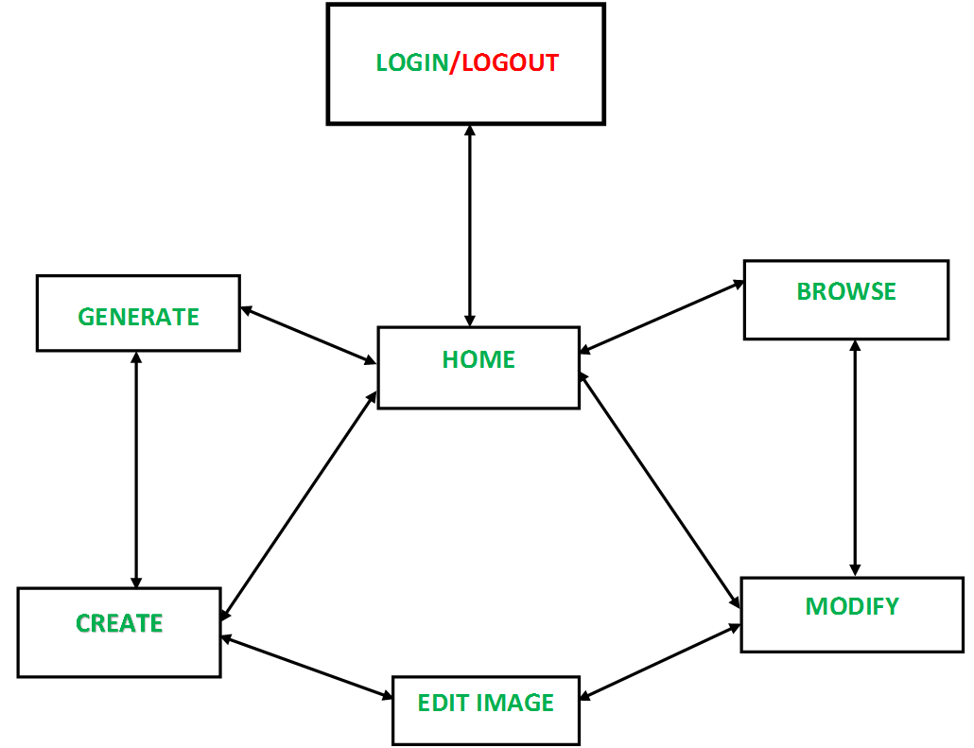
Diagrams Navigation

Slide 12
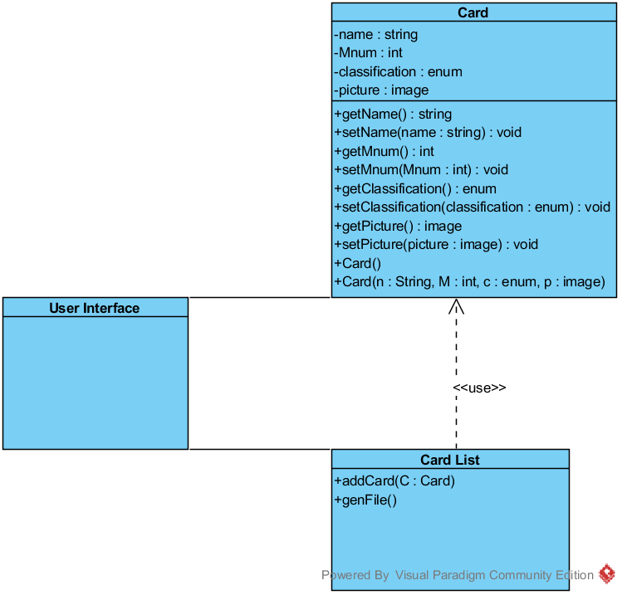
Diagrams Class

Slide 13
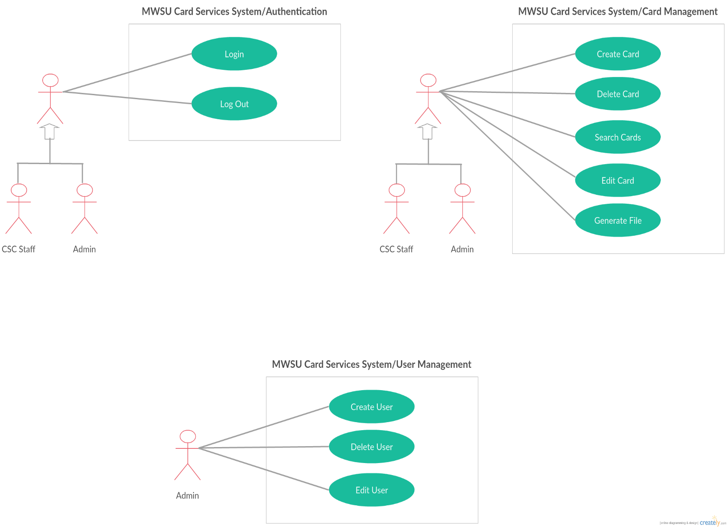
Diagrams Use Case

Slide 14
Development Tools XAMPP
*What is it?
*Points
*Points
*What we used it for
*Points
*Points

Slide 15
Development Tools Visual Paradigm
*What is it?
*Points
*Points
*What we used it for
*Points
*Points

Slide 16
Development Tools Notepad++
*What is it?
*Points
*Points
*What we used it for
*Points
*Points

Slide 17
Thank You! Questions?
References
*Points
*Points

